Slide 1
PAI 724:
Data Driven Decision making
LAB
Week 4 Lecture
September 26, 2022

Slide 2
Lecture Topic
Iteration

Slide 3
Programming basics
Programming logic
  Sequential: Perform statements one after another in order
  Conditional execution: Check for certain conditions and then execute or skip a sequence of statements
  Repeated execution: Perform some set of statements repeatedly, usually with some variation
  Reuse: Write a set of instructions once and give them a name then reuse those instructions as needed throughout your program

Slide 4
Programming basics
Programming logic
  Sequential: Perform statements one after another in order
  Conditional execution: Check for certain conditions and then execute or skip a sequence of statements
  Repeated execution: Perform some set of statements repeatedly, usually with some variation
  Reuse: Write a set of instructions once and give them a name then reuse those instructions as needed throughout your program

Slide 5
Iteration
Automate repetitive tasks
Update values based on previously assigned or generated ones
Draws on two particular commands:
  while
  for

Slide 6
While
While a particular condition holds, execute a set of instructions:
  Evaluate the condition, yielding True or False interpretation by Python
  If the condition is False, exit the while statement and continue execution at the next statement.
  If the condition is true, execute the body and then go back to revaluate the condition statement.
General format:
Variable and value assignment
Condition statement:
statement
statement
…
Subsequent statement

Slide 7
While
While a particular condition holds, execute a set of instructions:
  Evaluate the condition, yielding True or False interpretation by Python
  If the condition is False, exit the while statement and continue execution at the next statement.
  If the condition is true, execute the body and then go back to revaluate the condition statement.
General format:
Variable and value assignment
Condition statement:
statement
statement
…
Subsequent statement

Slide 8
Code Break

Slide 9
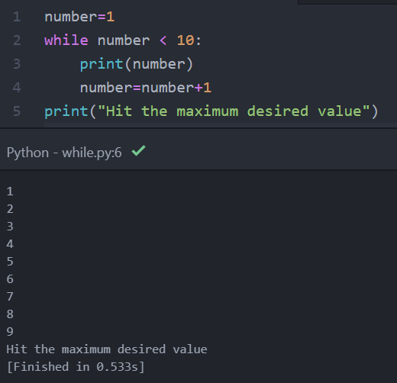
while

Slide 10
while

Slide 11
while
TRUE

Slide 12
while
For the first iteration:
complete the function:
number = number + 1
2 = 1 + 1
number was = 1
number now = 2
TRUE

Slide 13
while
2
For the second iteration:
complete the function:
number = number + 1
3 = 2 + 1
number was = 2
number now = 3
…
TRUE

Slide 14
while
10
For the first iteration variable in our list :
FALSE
…

Slide 15
Code Break

Slide 16
For
The while command allows you repeatedly execute a set of statements under different conditions
The for command allows you to execute a set of statements(i.e., loop through) for a set of things – words, lines in a file, list of numbers, etc.

Slide 17
For
General format:
variable = [list item 1, list item 2, list item 3…]
for itervar in variable:
statement
statement
…
statement

Slide 18
For
General format:
variable = [list item 1, list item 2, list item 3…]
for itervar in variable:
statement
statement
…
statement

Slide 19
Code Break

Slide 20
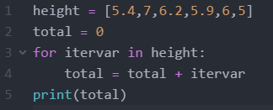
Thinking through the loops
Given this code,
what are we conceptually asking Python to do step-by-step?

Slide 21
Thinking through the loops
1
2
3
4
5
6
First, we have a list of six values

Slide 22
Thinking through the loops
1
2
3
4
5
6
Second, our starting point for the variable ‘total’ is zero

Slide 23
Thinking through the loops
1
2
3
4
5
6
For the first iteration variable in our list :
complete the function:
total = total + itervar
5.4 = 0 + 5.4
total was = 0
total now = 5.4

Slide 24
Thinking through the loops
1
2
3
4
5
6
Now, the function moves to the second iteration variable in our list :
complete the function:
total = total + itervar
12.4 = 5.4 + 7
total was = 5.4
total now = 12.4
5.4

Slide 25
Thinking through the loops
1
2
3
4
5
6
And this continues until the for-loop has moved through all of the iteration variables.
12.4

Slide 26
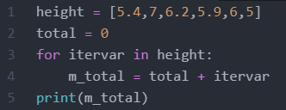
Thinking through the loops
So why does this for-loop not work?

Slide 27
Thinking through the loops
1
2
3
4
5
6
For the first iteration variable in our list :
complete the function:
m_total = total + itervar
5.4 = 0 + 5.4
total was = 0
total now = 0
m_total was =
m_total now = 5.4

Slide 28
Thinking through the loops
1
2
3
4
5
6
Now, the function moves to the second iteration variable in our list :
complete the function:
m_total = total + itervar
7 = 0 + 7
total was = 0
total now = 0
m_total was = 5.4
m_total now = 7

Slide 29
Thinking through the loops
1
2
3
4
5
6
Because the same variable is not on the left and the right of the equal sign in our for-loop, there is no iteration occurring.
You are not iteratively manipulating the same variable in each loop of your function.

Slide 30
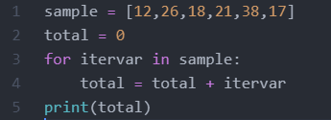
Thinking through the loops
Because the same variable is on the left and the right of the equal sign in our for-loop, you are iteratively manipulating the same variable in each loop of your function.

